Slide 1
Group Meeting
Jim Antonaglia
10/31/14

Slide 2

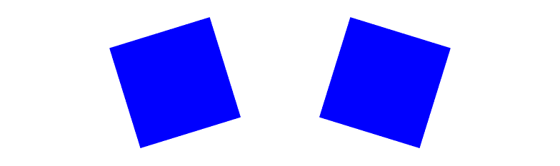
Recap: Dynamical modes
Anisotropic particle crystals:
  They exhibit vibrational modes (phonons)
  Also have librational modes (librons, yes)
  Generally coupled together
A vibrational mode
And a librational one
Notes:
Cubane is a great and illustrative example
C8H8 molecules make an (almost) fcc lattice that changes its rhombohedral angle and lattice constant when rotational degrees of freedom are liberated
Cubane also exhibits librational degrees of freedom and a libron spectrum

Slide 3

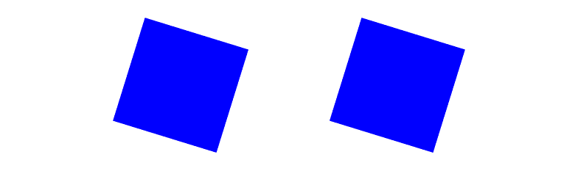
Librons are interesting because they have mass
Vibrational modes
Librational modes
energetic
energetic
not energetic
it depends
Notes:
Top: k \neq 0
Bottom: k = 0

Slide 4
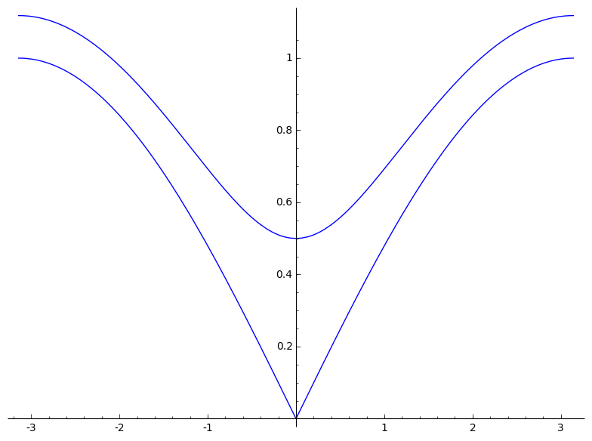
What does mass mean?
It's all in the dispersion relation:
We cannot arbitrarily excite libron modes! We need at least enough energy to provide for its mass.
Particle physics: mass
Condensed matter: band gap

Slide 5
Why does the libron have mass?
The libron has mass because there is bond order.
Orientation is coupled to the bond order, so if bond order is maintained, then orientational order is supported (until the bond order melts away).

Slide 6
How do we get dispersion in MC?
Correlation functions!
For a quadratic Hamiltonian, we can use the equipartition theorem for any degrees of freedom that we want:
Easier if we (at least partially) diagonalize the quadratic coupling matrix.
So let's go to a Fourier basis!

Slide 7
Fourier is a unitary transformation
This is the Fourier transform: x_{i} are the lattice positions, and u_{i} are the small displacements from the lattice positions
In 1D for a single field u, this is easy.
But what about n fields in d dimensions?
This only complicates things a little bit.
The frequency dispersion eigenvalues become a
frequency dispersion matrix.
Notes:
By field, here, what I mean is any quantity that is defined over space. Here, we're working with discrete fields u(r_i), whereas another field like the electric field is over continuous space. The continuum theory of elasticity is generated from here by taking k → 0 and by allowing the number of lattice points to grow to infinity.

Slide 8
Correlation function algorithm
Time average the particles' positions
For each time step, calculate
Using the known lattice vectors, calculate reciprocal lattice vectors and FT the field
Calculate correlation functions such as
Invert this matrix and read off the dispersion relation
For concreteness, let's talk about a specific model

Slide 9

2-D hard hexagon crystal
Start with a nearest neighbor approximation:
What do the stiffness constants mean? There's an effective crystal potential that we can expand about a known minimum.
The packing fraction at which the libron dispersion vanishes corresponds to the point where local rotational invariance is restored.
Notes:
We expect a density where the hexagons can all rotate freely yet remain tightly enough in a crystal. Essentially a kind of hard disk phase, which we're calling the rotator crystal phase. Above this density, there is too much resistance to rotation, so the libron shows up as a propagating wave of rotations.

Slide 10
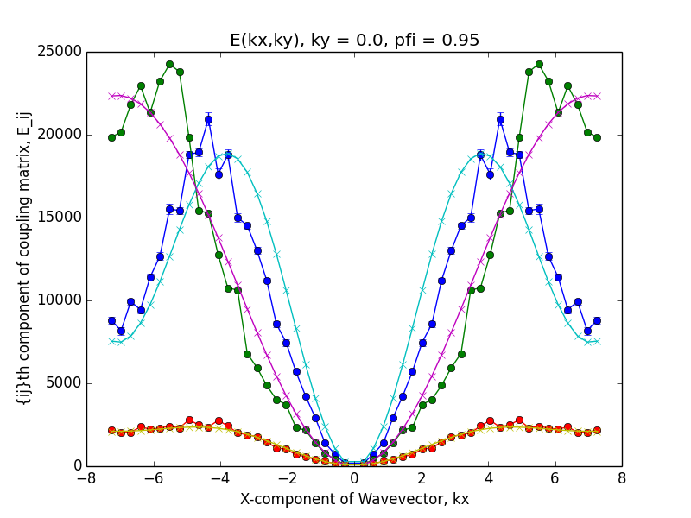
Transverse phonon
Longitudinal phonon
Libron
Notes:
D = 5.05 +- 0.06
E = 260.7 +- 0.3
A = 3730 +- 10

Slide 11
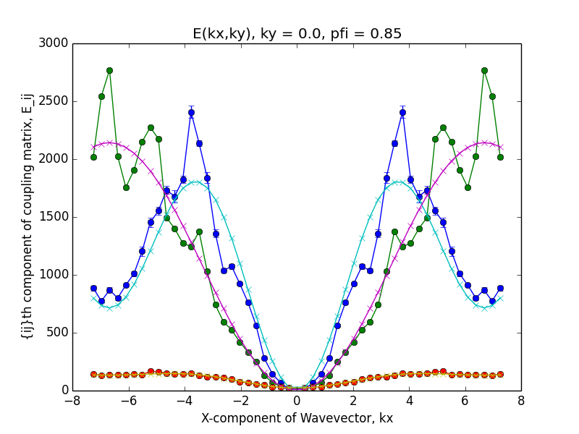
Transverse phonon
Longitudinal phonon
Libron
Notes:
D = 15.72 +- 0.01
E = 1.869 +- 0.008
A = 357 +- 1

Slide 12
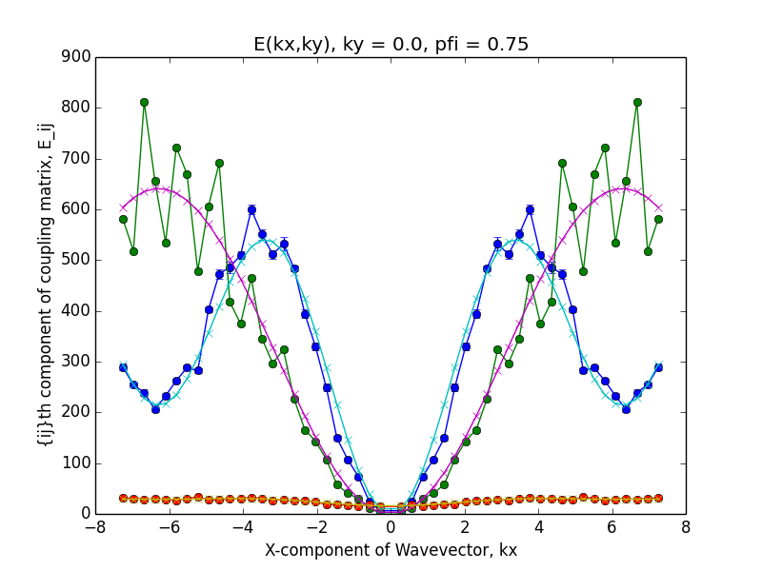
Transverse phonon
Longitudinal phonon
Libron
Notes:
D = 1.325 +- 0.001
E = 2.926 +- 0.002
A = 106.8 +- 0.3

Slide 13
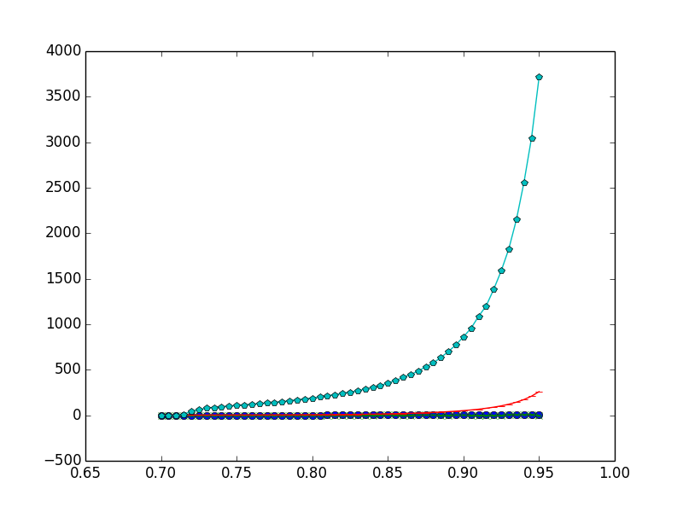
A
Coupling constant
E
B&D
Packing fraction

Slide 14
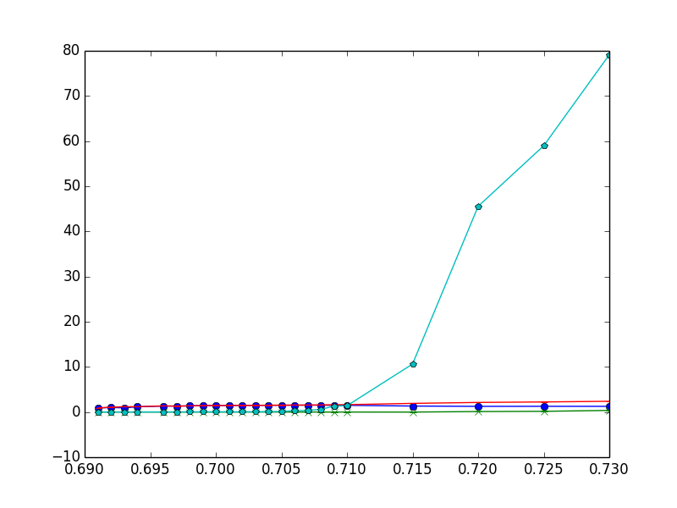
A
Coupling constant
E
D
B
Packing fraction

Slide 15
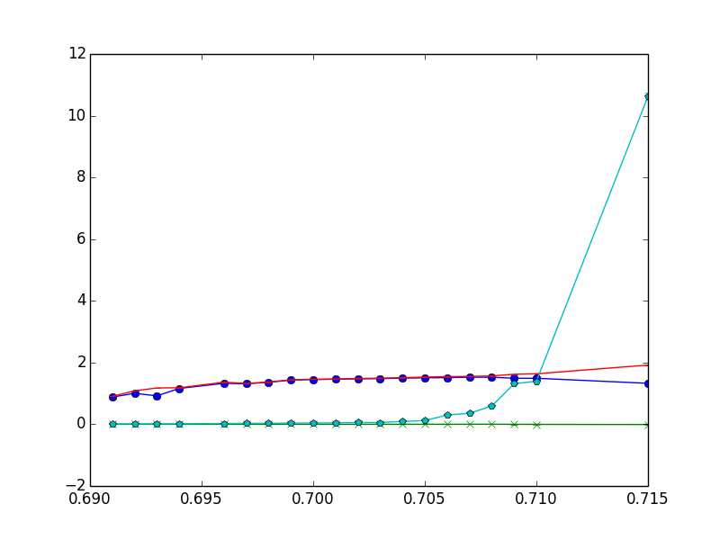
A
Coupling constant
E
D
B
Packing fraction

Slide 16
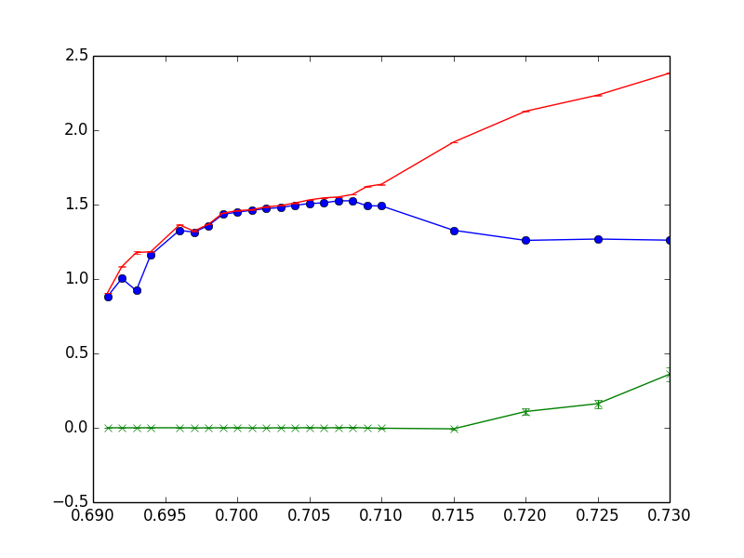
E
D
Coupling constant
B
Packing fraction
Notes:
Do we trust this stuff near the end?

Slide 17
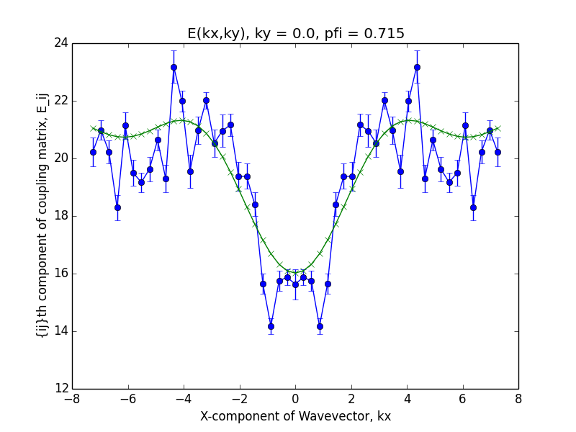

Slide 18
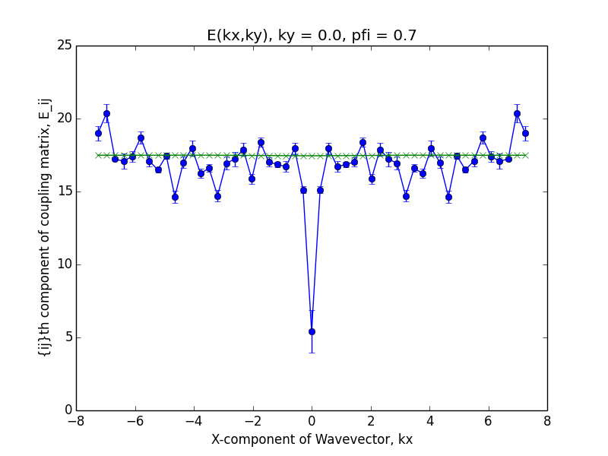

Slide 19
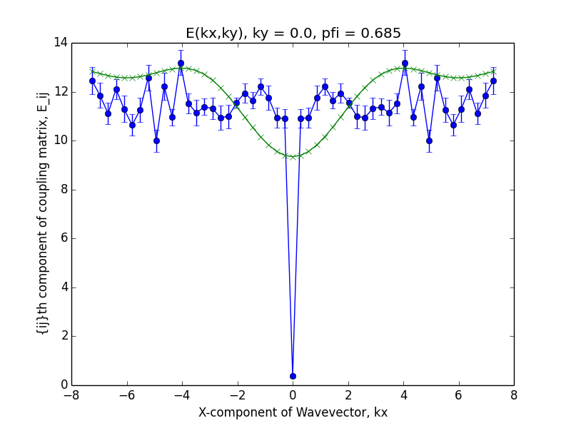

Slide 20
After melting
Fourier transform is with respect to a fixed lattice. Once the lattice is totally melted, the meaning of the Fourier transform is lost.
It should probably only be trusted up until the point that the phonon constant goes to 0.
Need to find some other way to investigate the massive libron mode.
Spike at k=0 is the mass going to 0.

Slide 21
Main takeaways
Need a new method after the crystal has melted to explore the orientation rigidity. Probably need to go to larger and larger systems.
Orientation is coupled to bond order, which is maintained in the hexatic phase. Since there is no hexatic phase in 3D, could perform analysis in 3D.
Polygons without a hexatic phase should not maintain the libron mode (heptagons? Which ones were these?)

Slide 22
Future work
Rounded hexagons or other hard polygons
3-D: broken gauge symmetry is non-Abelian, which is a whole suite of complications, but probably rich behavior
Could explore the hexatic phase and the effect of its coupling to this orientational degree of freedom. What are the dynamical modes corresponding to the hexatic bond angle? Is this massive as well? Is it that the hexatic phase and orientational crystal buttress each other?

